Slide 1

DevOps explained
© 2020 andreas golgath

Slide 2
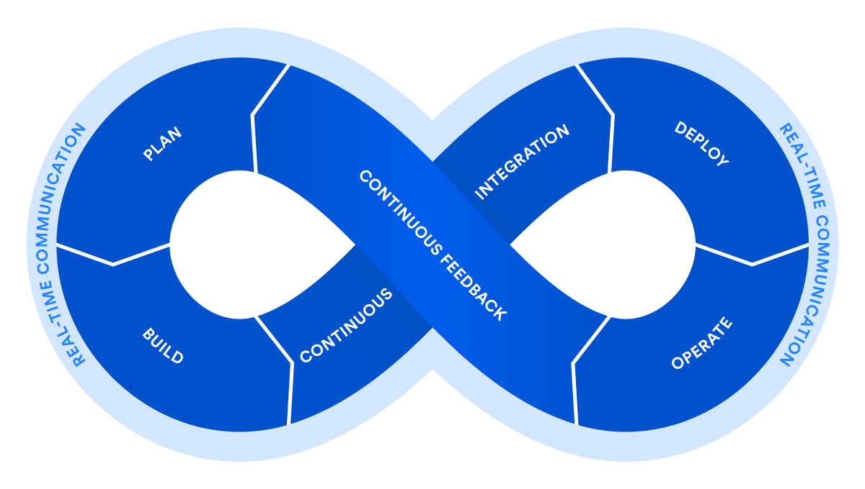
DevOps Breaking the Development-Operations Barrier
DevOps is a set of practices that automates the processes between software development and IT teams, in order that they can build, test, and release software faster and more reliably.
The concept of DevOps is founded on building a culture of collaboration between teams that historically functioned in relative siloes. The promised benefits include increased trust, faster software releases, ability to solve critical issues quickly, and better manage unplanned work.
Source: https://atlassian.com/devops

Slide 3
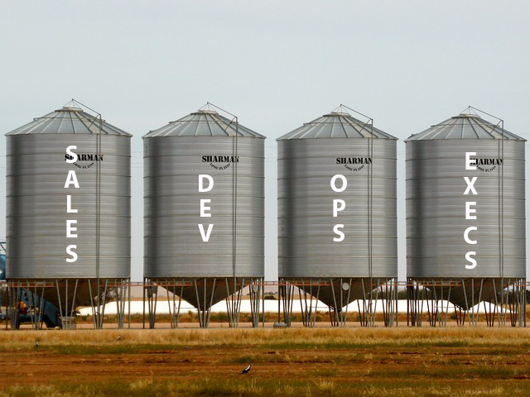
Advantages of DEVOPS
Cross-Functional collaboration and trust
Team Building => less friction
Elimination of routine work
Automated development, tests, Deployment, and Provisioning
Using infrastructure as code, environments can be deployed fast and reproducible
Faster releases and more intelligent working
ContInuous improvement
Shorter development cycles (e.g. once per sprint)
Faster feedback for the customer and by the customer
Faster problem resolution time
Happier customers
Improved management of unplanned work
Faster reaction time
DevOps ist nicht die Sache einer Einzelperson. Alle sind gemeinsam gefragt (Christophe Capel, Principal Product Manager, Jira Service Desk)

Slide 4
DevOps Essentials
Vision
Backlog
Code
Build
Test
Release
Deploy
Operate
DevOps
Continuous Delivery
Continuous Integration
Agile Development
Source: devops.ch (https://www.devops.ch/2016/12/28/devops-essentials/)
„DevOps - Agile Softwareentwicklung konsequent zu Ende gedacht.“ (TechDOSSIER, Sept. 2017)

Slide 5
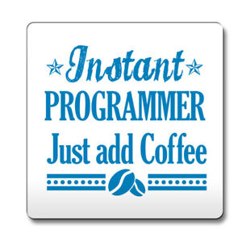
Everything as code = AutomatiNG Routine JOBs
Infrastructure as Code
Managing infrastructure
Introducing Idempotence (Wiederholbarkeit von Anweisungen)
Testing Artifacts early on in environments close to production
E.g. Terraform
Test as Code
Using automated tests
Configuration as Code
Reproducible Management
Pipeline as Code
Continuous Integration / Continuous Delivery
„Software Industrialisation“
Higher degree of automation of labor-intensive and repetitive process steps
Higher software quality by using a coordinated tool chain
HIGHER cost efficiency and competitive advantage
What is Infrastructure as Code? https://docs.microsoft.com/en-us/azure/devops/learn/what-is-infrastructure-as-code
Mario-Leander Reimer: Everything-as-Code – Ein vielsprachige Reise, JavaLand 2017 https://de.slideshare.net/QAware/everythingascode-polyglotte-softwareentwicklung

Slide 6
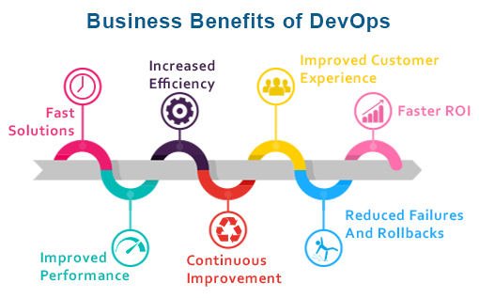
The Benefits of DevOps
Source: https://www.veritis.com/solutions/devops/automation-services/

Slide 7
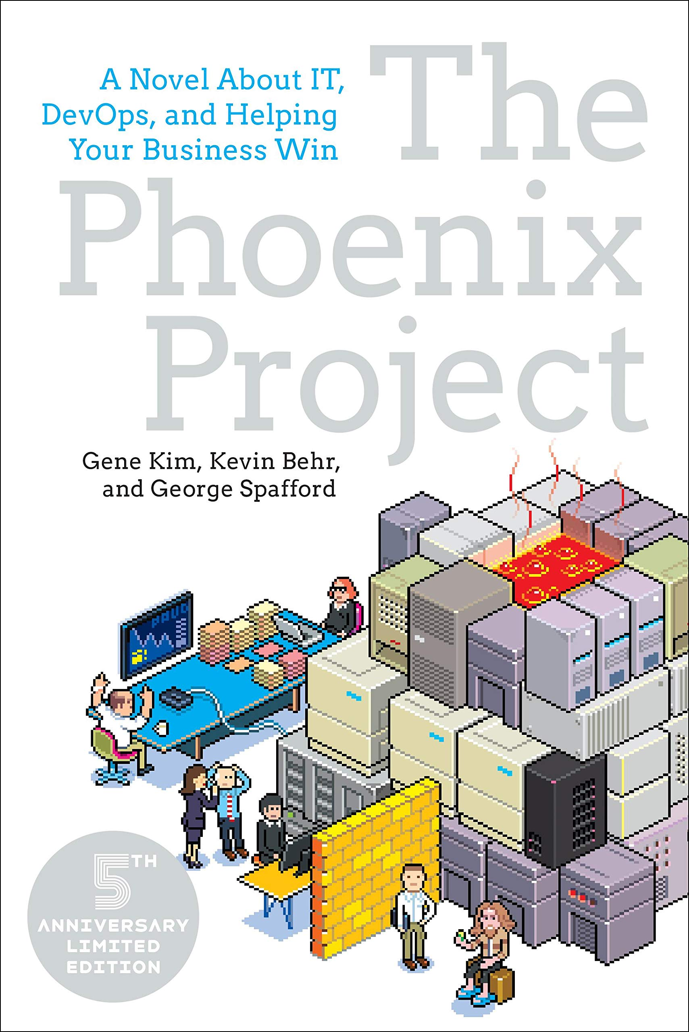
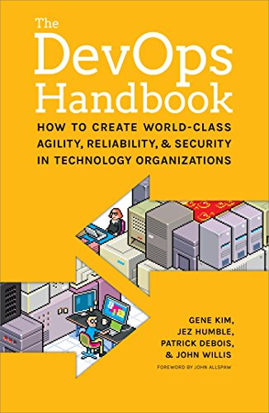

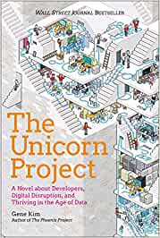

Gene Kim
2012
2016
2018
Together with John Willis, Patrick Debois and Jez Humble
2019
https://itrevolution.com/

Slide 8
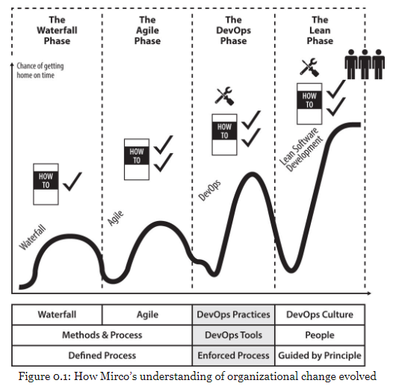
Mirco Hering: DevOps for the Modern Enterprise
Oh No, there are phases again…

Slide 9

Other Fun Reading Material

Slide 10
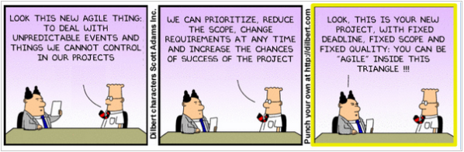
Why is Dilbert so close to the truth?

